Slide 1

Replication Project: “Household education gaps and gender role attitudes” Giani, Hope & Skorge (2022)
Applied Statistical Analysis II​
Presented by Matilda Tomatis ​

Slide 2
Original Paper - Introduction
It’s a 2022 paper, published in the Political Science Research and Methods by Giani, Hope & Skorge.
It investigates how educational gap within the household mediate one’s gender childcare bias, hereby expressed as the difference in approval of a mother versus a father having a full-time job while having children under the age of three.
The findings align with a resource-bargaining framework.

Slide 3
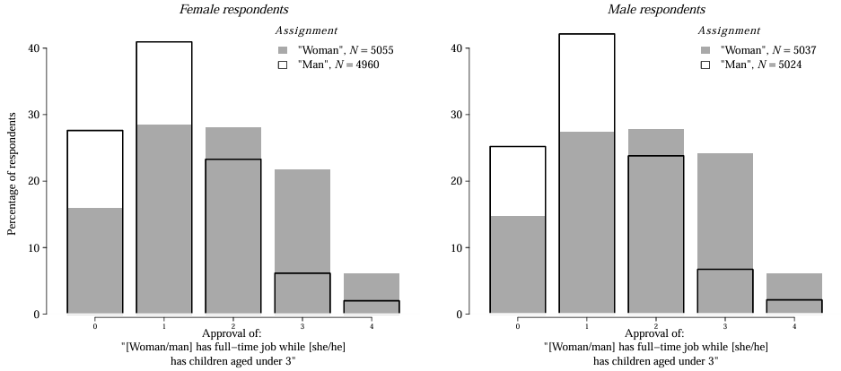
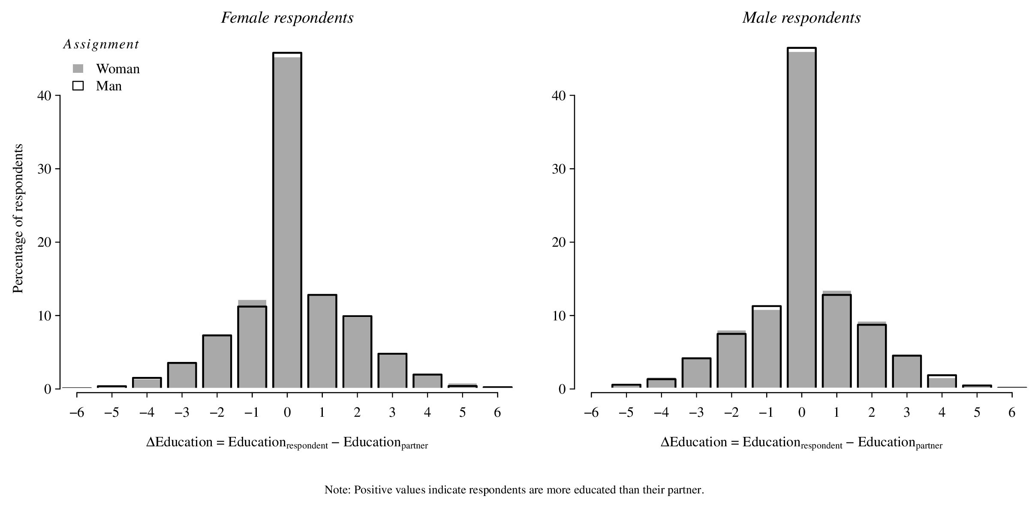
Data – European Social Survey
2018 ESS (Round 9) data, face-to-face survey carried out in 19 EU countries.
Dependent variable of interest: Approval. On a scale from 0 (Strongly approve) to 4 (Strongly Disapprove).
Main independent variables:
Vignette Gender: half of the respondents were asked about a mother and half about a father, binary variable.
Household Education Gap: the difference in the respondent education minus that of their partner, discrete variable spanning from -6 to +6.

Slide 4
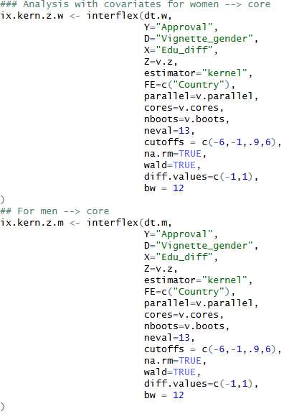
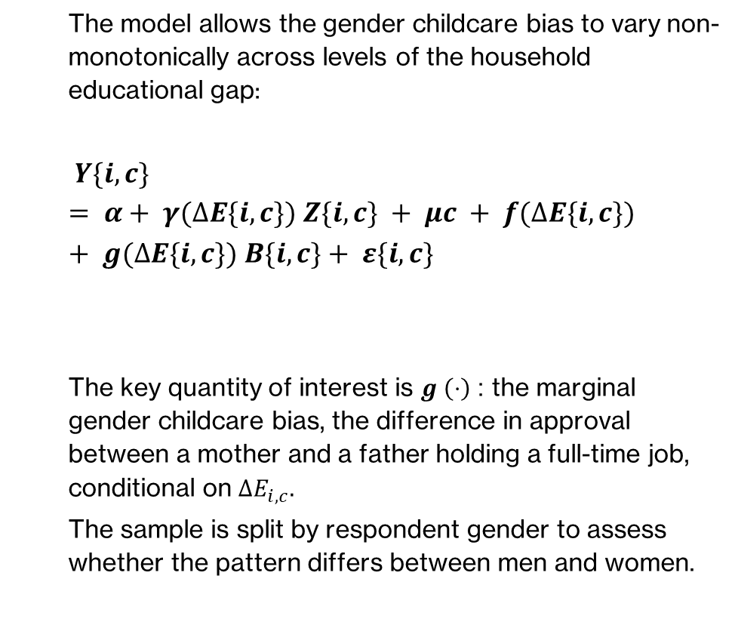
Original Model: Gaussian Kernel Interflex (Hainmueller, Mummolo and Xu, 2019)
The model allows the gender childcare bias to vary non-monotonically across levels of the household educational gap:
$$Y\{i,c\}= α+ γ(∆E\{i,c\}) Z\{i,c\} + μc + f(∆E\{i,c\}) + g(∆E\{i,c\}) B\{i,c\}+ ε\{i,c\}$$
The key quantity of interest is $g \left(⋅\right)$: the marginal gender childcare bias, the difference in approval between a mother and a father holding a full-time job, conditional on $ΔE_{i,c}.$
The sample is split by respondent gender to assess whether the pattern differs between men and women.

Slide 5
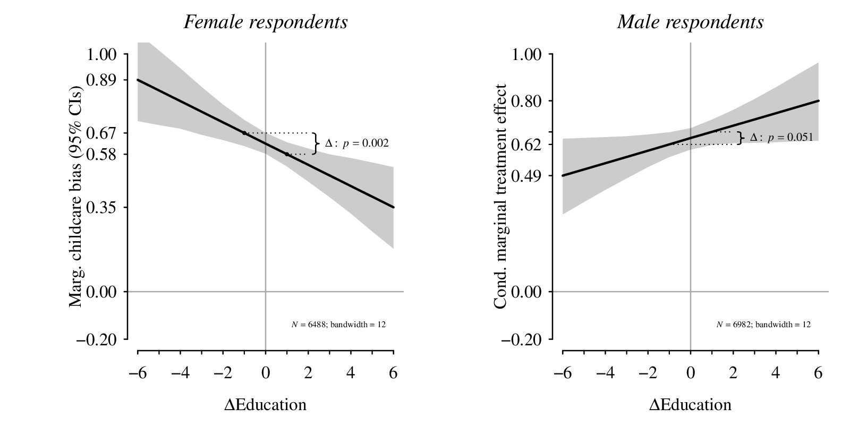
Main Findings
For female respondents, as the household education gap increase in their favour, their gender childcare bias tends to diminish.
For male respondents the opposite trend is observed: as the educational gap increases in their favour, they tend to have a bigger gender bias.
These findings are in line with a resource-bargaining framework: women who out-educate their partners hold more power in the household and hold more egalitarian attitudes; men show the opposite pattern.

Slide 6
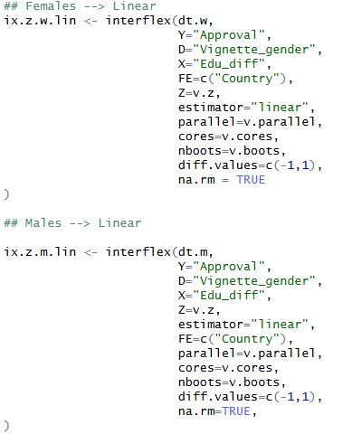
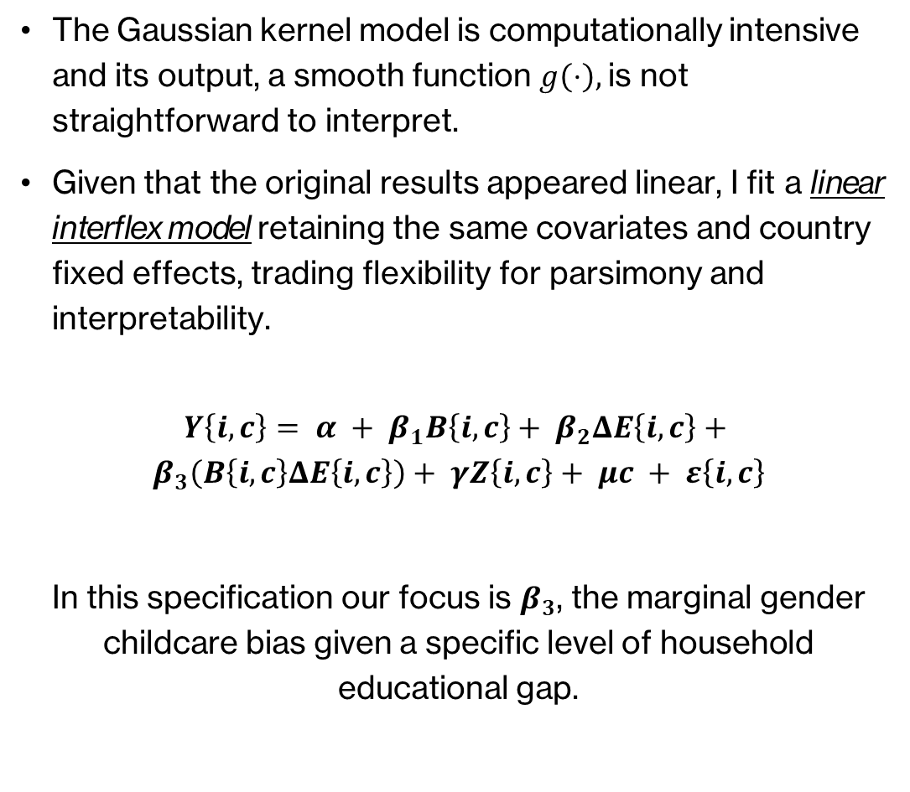
My Contribution: Linear Interflex Model
The Gaussian kernel model is computationally intensive and its output, a smooth function $g\left(⋅\right),$is not straightforward to interpret.
Given that the original results appeared linear, I fit a linear interflex model retaining the same covariates and country fixed effects, trading flexibility for parsimony and interpretability.
$$Y\left\{i,c\right\}= α + β_{1}B\left\{i,c\right\}+ β_{2}ΔE\left\{i,c\right\}+$$
$$β_{3}\left(B\left\{i,c\right\}ΔE\left\{i,c\right\}\right)+ γZ\left\{i,c\right\}+ μc + ε\left\{i,c\right\}$$
In this specification our focus is $β_{3}$, the marginal gender childcare bias given a specific level of household educational gap.

Slide 7
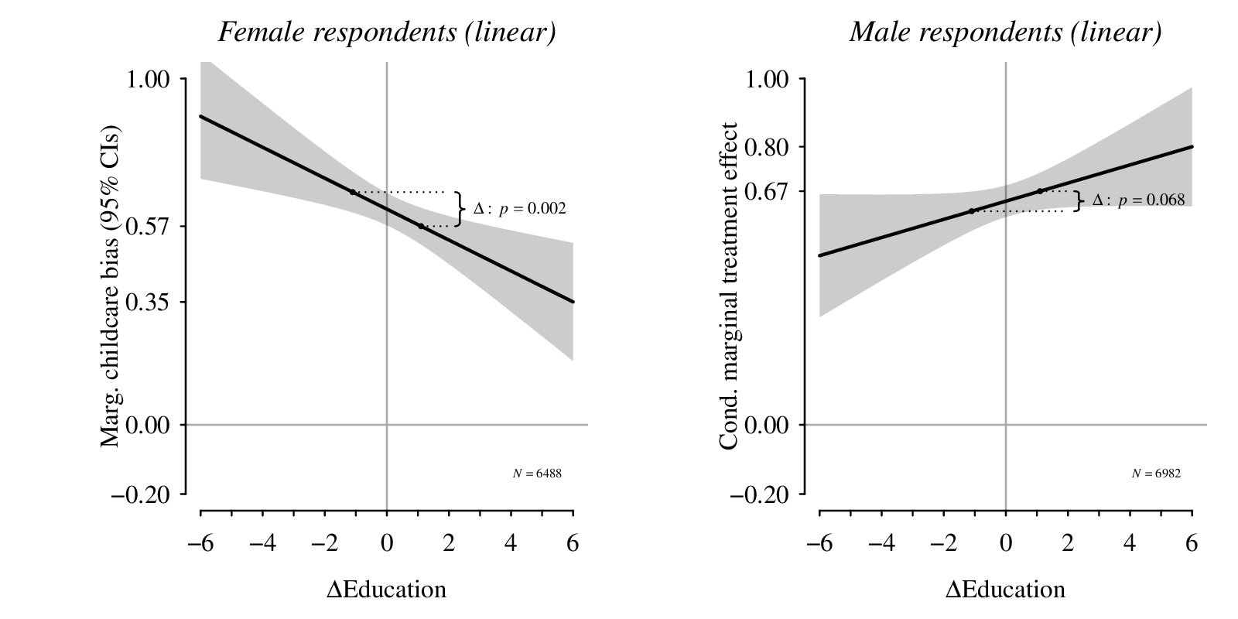
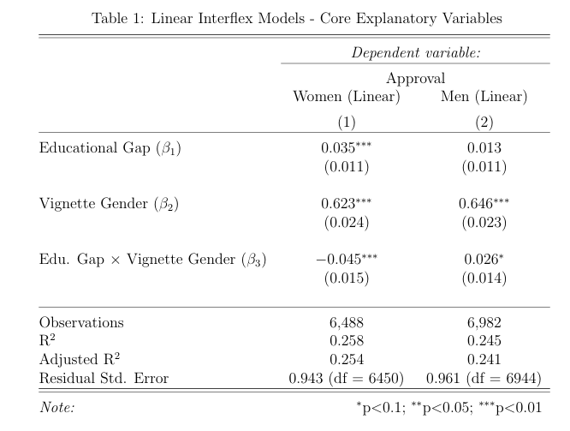
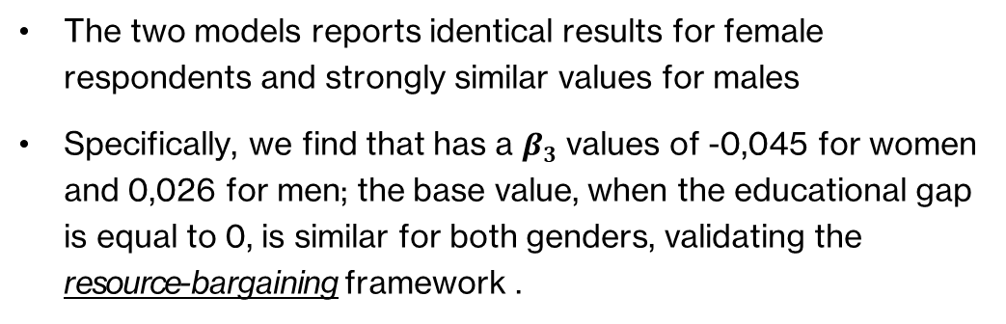
My Findings
The two models reports identical results for female respondents and strongly similar values for males
Specifically, we find that has a $β_{3}$values of -0,045 for women and 0,026 for men; the base value, when the educational gap is equal to 0, is similar for both genders, validating the resource-bargaining framework .
In conclusion: The results are near-identical across both specifications, suggesting the added complexity of the kernel model was unnecessary.

Slide 8

Q & A
Thank you for your attention

